Slide 1
Unit-1 Introduction to Computer Graphics

Slide 2
Outline
What is Computer Graphics?
Advantages of Computer Graphics.
Application of Computer Graphics.
Input devices.
Graphics software and standard.
Basics of Computer Graphics.
Various display devices.
Raster graphics system.
Random graphics system.

Slide 3
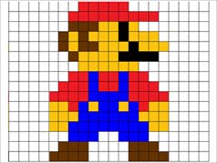
What is Computer Graphics?
Computer graphics is an art of drawing lines, charts, pictures, etc. using computers with the help of programming and tools.
Computer graphics image is made up of number of pixels.
Picture Element (Pixel) is the smallest addressable graphical unit represented on the computer screen.

Slide 4

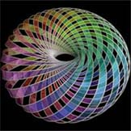

Advantages of Computer Graphics
Computer graphics is one of the most effective and commonly used ways of communication with computer.
It provides tools for producing picture
“real-world”
synthetic objects such as mathematical surfaces in 4D
data like survey result.

Slide 5


Contd.
produce animations
control the animation by adjusting the speed, portion of picture

Slide 6
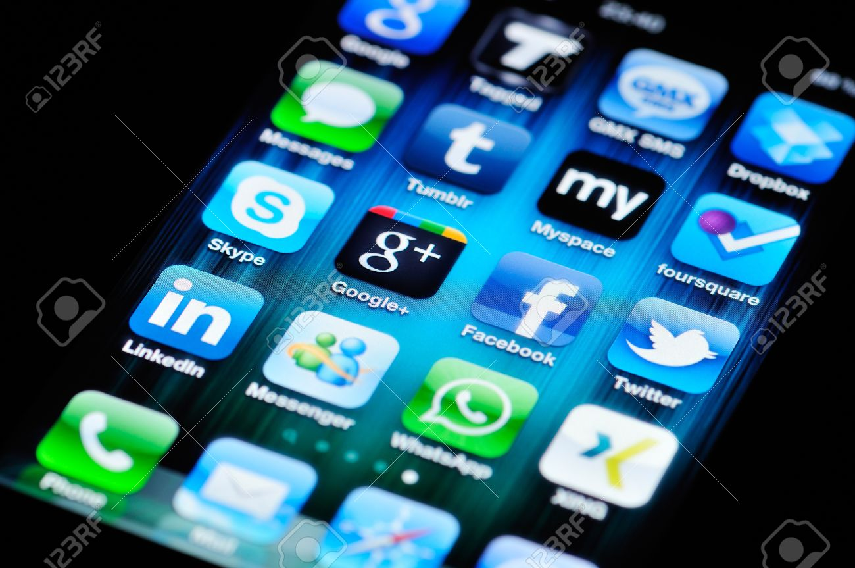

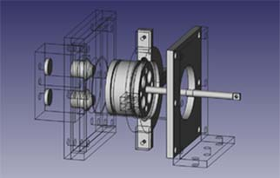
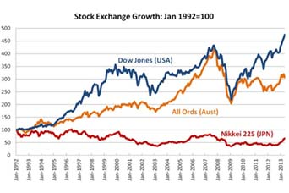
Application of Computer Graphics
User interface
Example: App icon
Simulation and animation
Example: Cartoon films
Plotting of graphs and charts
Example: Stock exchange
Computer aided drafting and design
Example: Automobile parts designing
Source: https://www.123rf.com
Source: http://opensourceecology.org/
Source: http://www.abc.net.au/
Source: http://giphy.com/

Slide 7


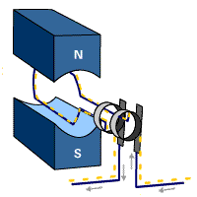

Contd.
Art and commerce
Example: Creative pictures
Cartography
Example: Geographic maps
Education and training
Example: Models of physics
Image processing
Example: Editing Photos
Source: conncoll.edu
Source: pinterest.com
Source: school-for-champions.com
Source: http://chainimage.com/

Slide 8

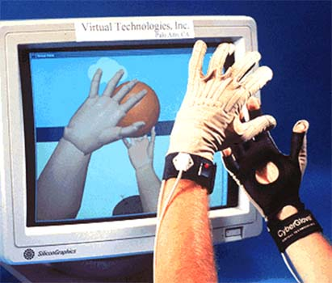
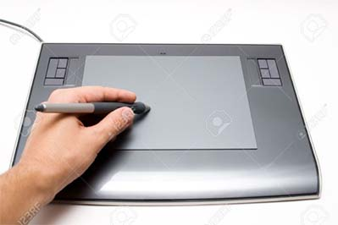
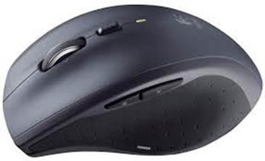

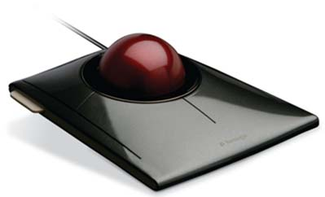
Input Devices
Keyboards
Mouse
Trackball and Space ball
Joysticks
Data glove
Digitizer

Slide 9
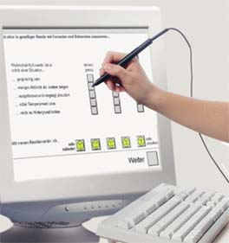
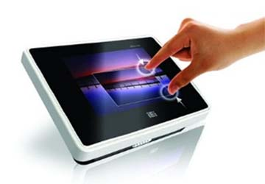
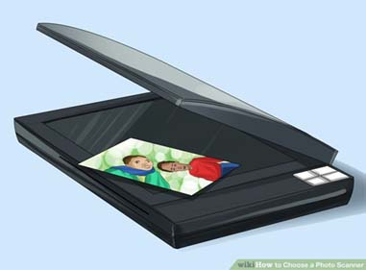

Contd.
Image Scanner
Touch Panels
Touch input can be recorded with following methods.
Optical methods
Electrical methods
Acoustical methods
Light pens
Voice systems
Source: http://mastersofmedia.hum.uva.nl/blog/2015/09/14/hey-siri-do-you-spy-on-me/
Source: industrysearch.com.au
Source: javatpoint.com/input-devices
Source: wikihow.com

Slide 10
Basics of Computer Graphics
In computer graphics picture or graphics objects are presented as a collection of discrete pixels.
We can control intensity and color of pixel which decide how picture look like.
The special procedure determines which pixel will provide the best approximation to the desired picture or graphics object, this process is known as Rasterization.
The process of representing continuous picture or graphics object as a collection of discrete pixels is called Scan Conversion.
8

Slide 11
Display Devices
Display devices are also known as output devices.
Following devices we are going to study:
Cathode ray tube (CRT)
Direct-view storage tubes (DVST)
Plasma Panels displays
Thin Film Electroluminescent Displays
Light Emitting Diode (LED)
Liquid Crystal Display (LCD)
Stereoscopic system
Virtual-reality

Slide 12
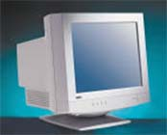
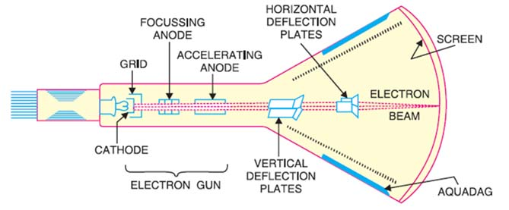
1. Cathode-Ray-Tubes

Slide 13
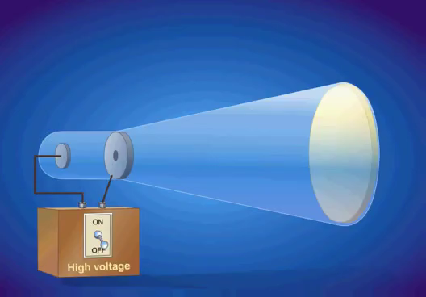
Contd.
Source: https://youtu.be/GzMh4q-2HjM

Slide 14
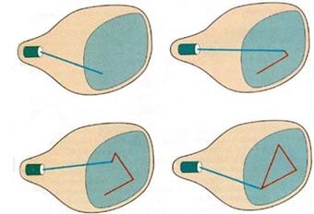
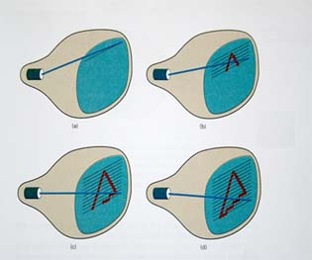
Contd.
There are two techniques used for producing images on the CRT screen:
Vector scan/Random scan display.
Raster scan display.
Vertical Retrace
Horizontal Retrace
OFF
ON
Source: tutorialspoint.com
Source: eenadupratibha.net

Slide 15

Architecture of a Vector Display
CPU
I/O Port
Display buffer memory
(Interaction data)
(Display command)
CRT
Display controller
Keyboard
Mouse

Slide 16
Architecture of a Raster Display
CPU
I/O Port
(Interaction data)
(Display command)
Keyboard
Display controller
Mouse
00000000000000000000001111100000000000000010000000000000000100000000000000001000000000
CRT
T
Video controller
Refresh buffer

Slide 17
Random Scan v/s Raster Scan
Base of Difference | Raster Scan System | Random Scan System
Electron Beam | The electron beam is swept across the screen, one row at a time, from top to bottom. | The electron beam is directed only to the parts of screen where a picture is to be drawn.
Resolution | Its resolution is poor. | Its resolution is good.
Picture Definition | Picture definition is stored as a set of intensity values for all screen points, called pixels in a refresh buffer area. | Picture definition is stored as a set of line drawing instructions in a display file.

Slide 18
Contd.
Base of Difference | Raster Scan System | Random Scan System
Realistic Display | The capability of this system to store intensity values for pixel makes it well suited for the realistic display of scenes contain shadow and color pattern. | These systems are designed for line-drawing and can’t display realistic shaded scenes.
Draw image | Screen points/pixels are used to draw an image. | Mathematical functions are used to draw an image.

Slide 19
Color CRT Monitors
There are two basic techniques for color display:
Beam-penetration technique
Shadow-mask technique

Slide 20
Beam-Penetration Technique
In this technique screen is coated with two colours. Outer layer with green and inner layer with red.
Slow speed electron beam strike on red layer and produce red colour.
Intermediate speed electron beam strike on red and green layer and produce two colour orange and yellow.
High speed electron beam penetrate red and strike on yellow layer and produce yellow colour.
Slow Speed Electron Beam
Intermediate Speed Electron Beam
High Speed Electron Beam

Slide 21
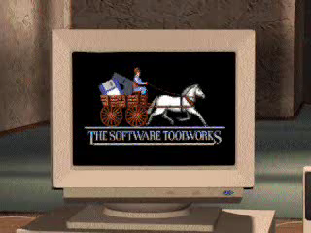
Shadow-Mask Technique
Source: https://youtu.be/_O-2D5ryb2A

Slide 22
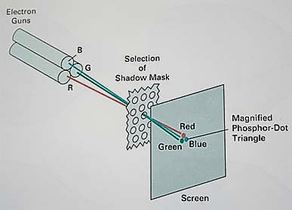
Cond.
Source: http://nptel.ac.in/

Slide 23
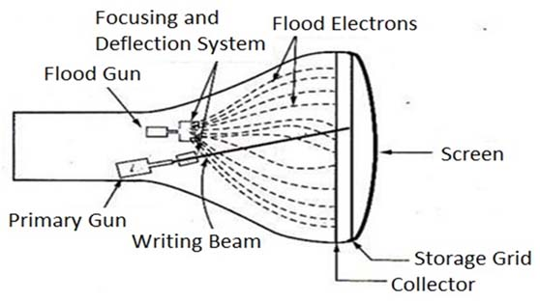
Direct-View Storage Tubes (DVST)
Source: graphicsnotes.wordpress.com

Slide 24
Flat Panel Display
The term flat panel display refers to a class of video device that have reduced volume, weight & power requirement compared to a CRT.
We can separate flat panel display in two categories:
Emissive displays: - the emissive display or emitters are devices that convert electrical energy into light.
Ex. Plasma panel, thin film electroluminescent displays and light emitting diodes.
Non emissive displays: - non emissive display or non emitters use optical effects to convert sunlight or light from some other source into graphics patterns.
Ex. LCD (Liquid Crystal Display).

Slide 25
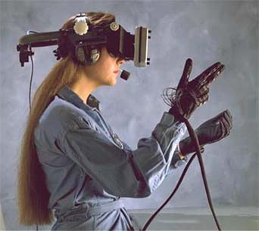
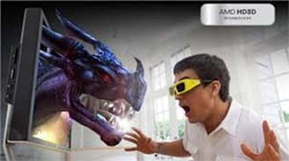
Stereoscopic & Virtual-Reality Systems
Source: chip.com.tr
Source: pinterest.com

